Slide 1
Errors та Exceptions
в Python.
Університет ім.А.Нобеля
кафедра Інформаційних технологій
професор Рижков Ігор Вікторович

Slide 2
Errors vs Exceptions
syntax error
exceptions
They result from a violation of the programming language syntax when writing source code. If there are such errors, the program cannot be compiled. When working in any development environment, for example, in PyCharm, the IDE itself can track syntax errors and allocate them in some way.
It is runtime errors.
They appear in the already compiled program during its execution. When that error occurs, Python generate an exception that can be handled, which avoids your program to crash.

Slide 3

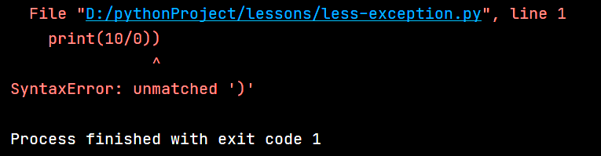

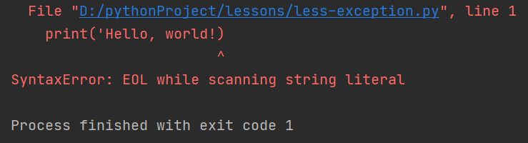
Syntax error

Slide 4

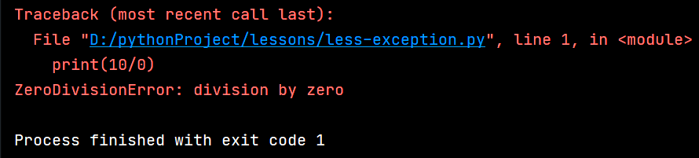

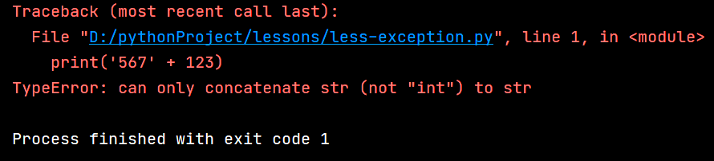
Exceptions

Slide 5
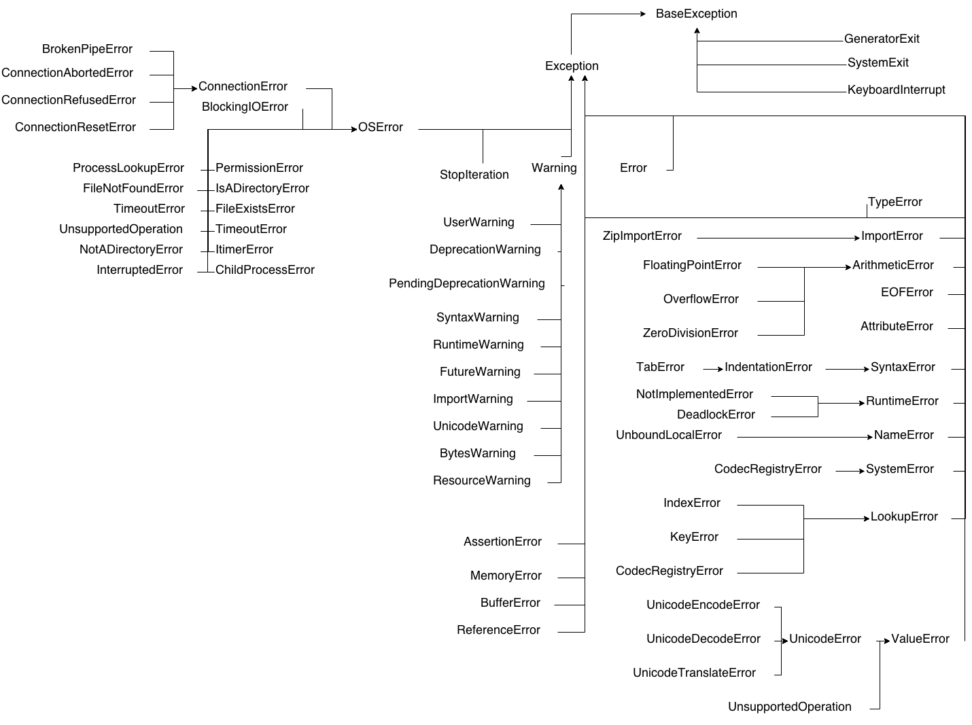

Slide 6
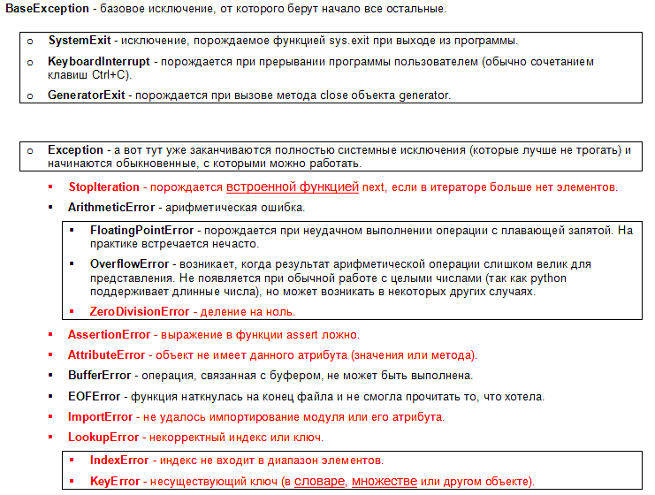

Slide 7
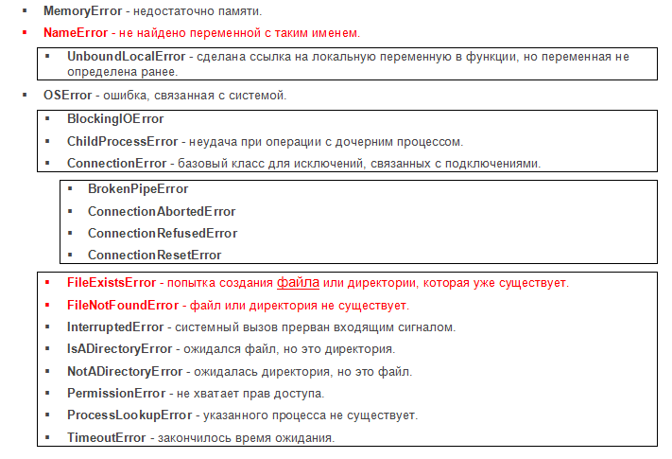

Slide 8
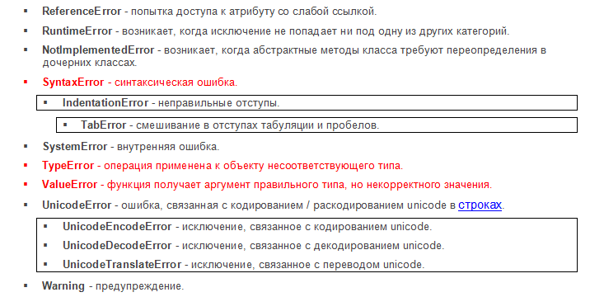

Slide 9
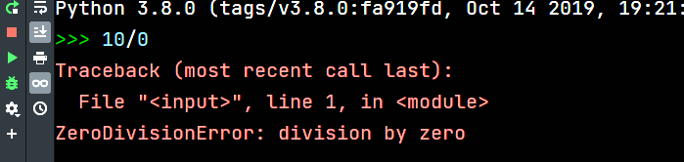
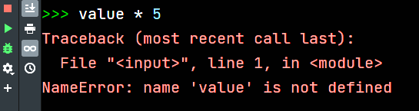
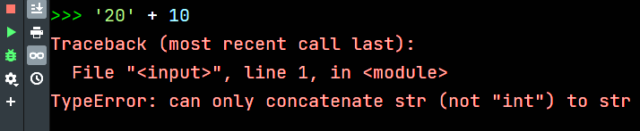

Slide 10
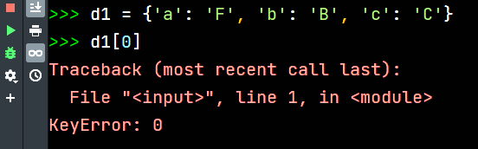
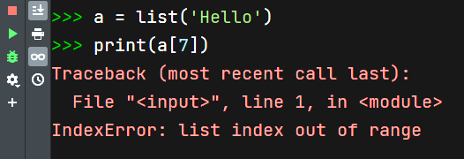
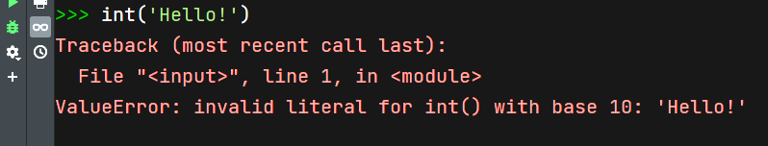

Slide 11
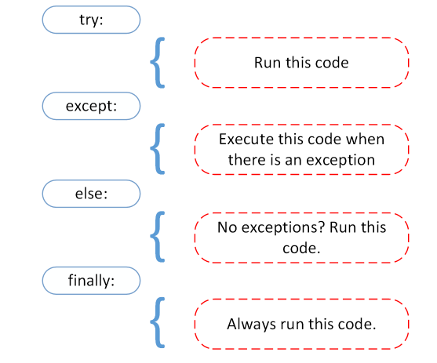

Slide 12
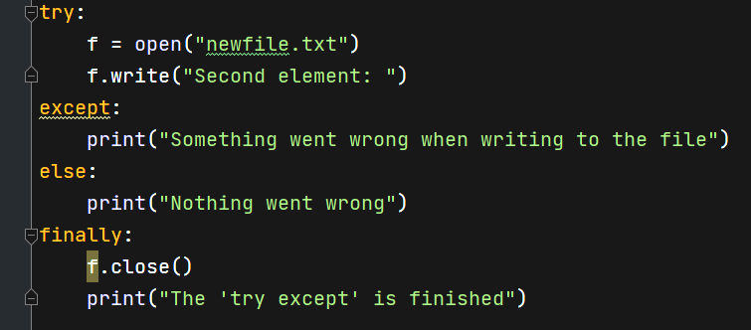

Slide 13
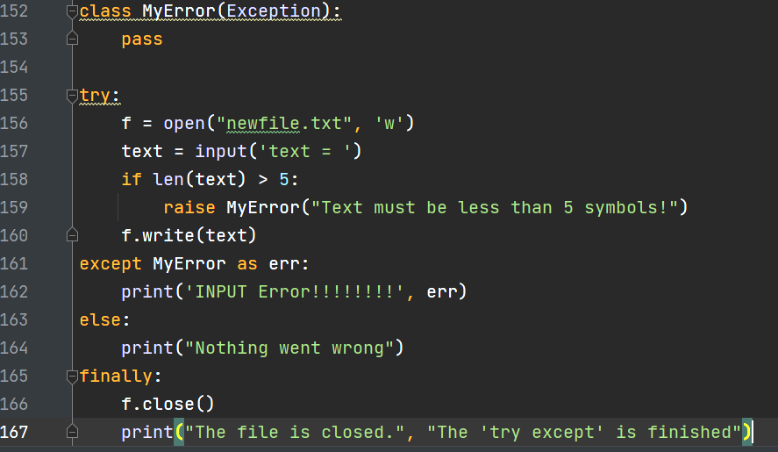

Slide 14
